Slide 1
Web Programming
Express - NODE - request - response
Lecture 24
Mahhek Khan
Notes:
.

Slide 2
What is Express?
Express is a minimal and flexible Node.js web framework.
It simplifies building web servers and APIs.
Built on top of Node.js’s http module.
Handles routing, middleware, request/response easily.
"Express helps you build fast and clean server-side applications."

Slide 3
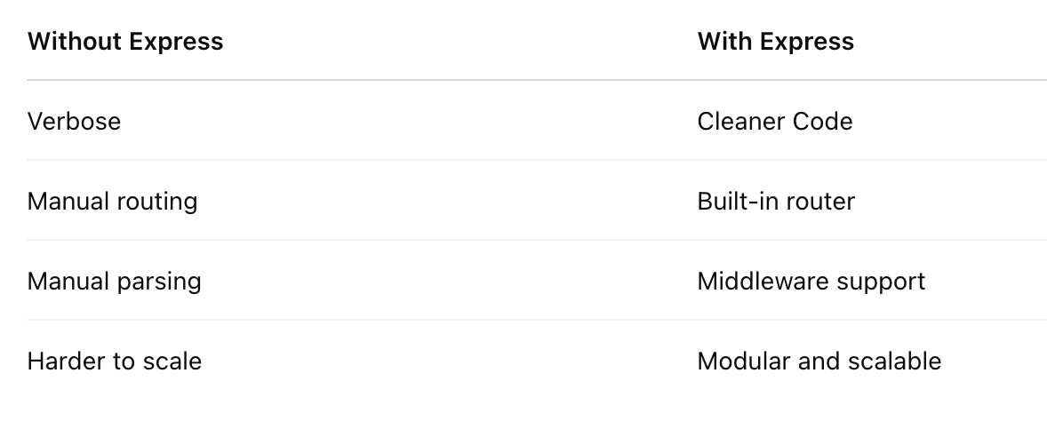
Why Use Express?

Slide 4
Core Features
Routing: Define URLs and methods easily
Middleware: Code that runs before the route handler
Error Handling: Built-in tools for handling errors
Request & Response Utilities: Send JSON, status codes, etc.

Slide 5
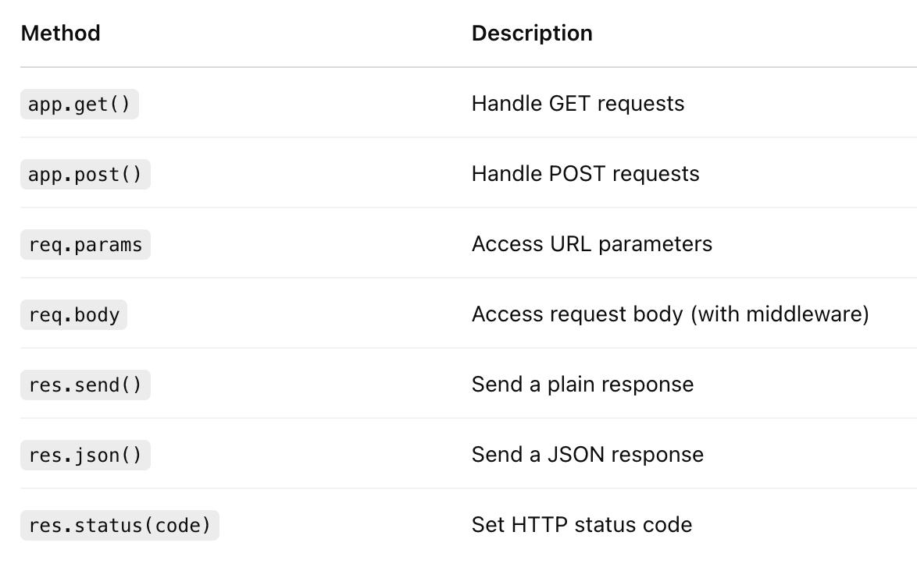
Common Express Methods

Slide 6
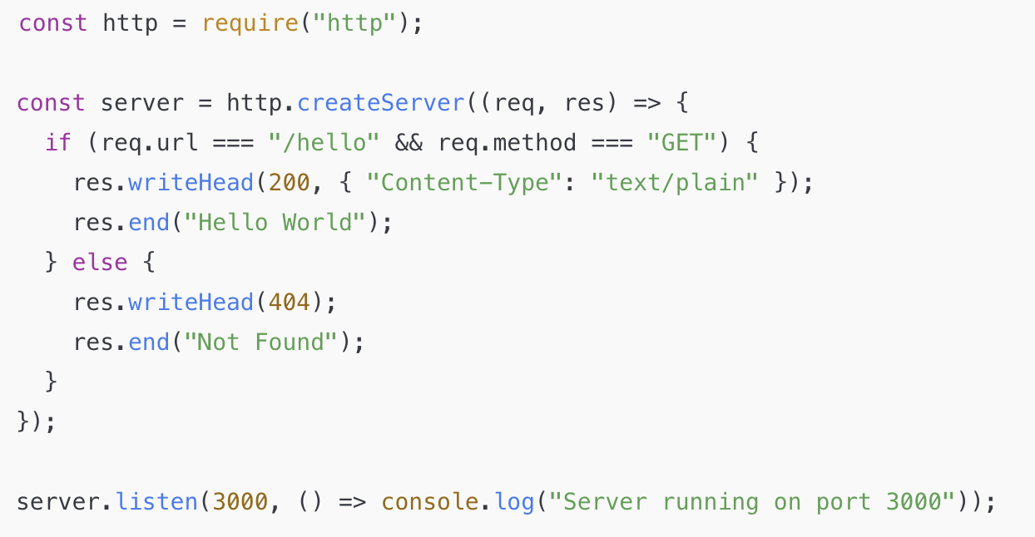
Node.js without Express

Slide 7
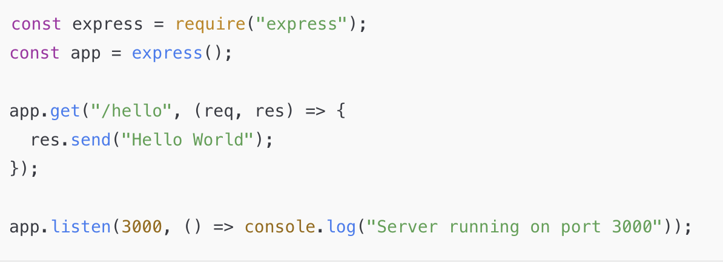
Node.js with Express

Slide 8
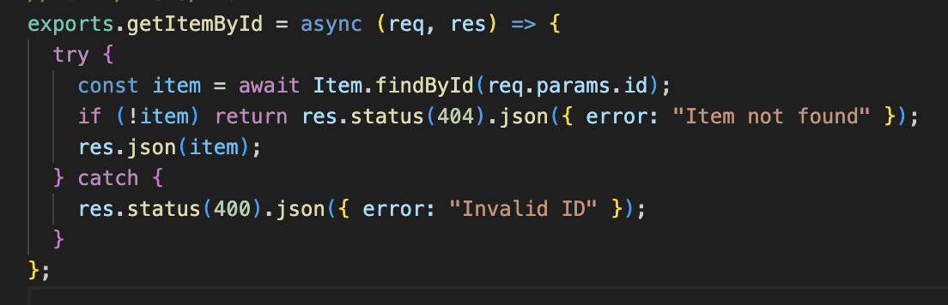
What is req and res?
In Express, every route handler gets two key objects:
req: represents the HTTP request.
res: represents the HTTP response.

Slide 9
The req object
Contains information sent from client to server
Common properties:
req.params
req.query
req.body
req.headers
req.method
req.url

Slide 10
Path Parameters (req.params)
PATCH /items/12345678
Content-Type: application/json
{
"name": "Updated Item",
"quantity": 20
}
→ req.params.id === "12345678"

Slide 11
Query Parameters
Data sent in the URL after ?
exports.searchItem = async (req, res) => {
const searchTerm = req.query.term;
};
URL: /search?term=book → req.query.term === "book"

Slide 12
Body Parameter
Used in POST/PUT/PATCH requests
PATCH /items/12345678
Content-Type: application/json
{
"name": "Updated Item",
"quantity": 20
}
const { name, quantity } = req.body;

Slide 13
Header, Method, URL
exports.searchItem = async (req, res) => {
console.log('Method:', req.method); // e.g., "GET"
console.log('URL:', req.url); // e.g., "/search?term=book"
console.log('Headers:', req.headers); // logs all incoming headers
};

Slide 14
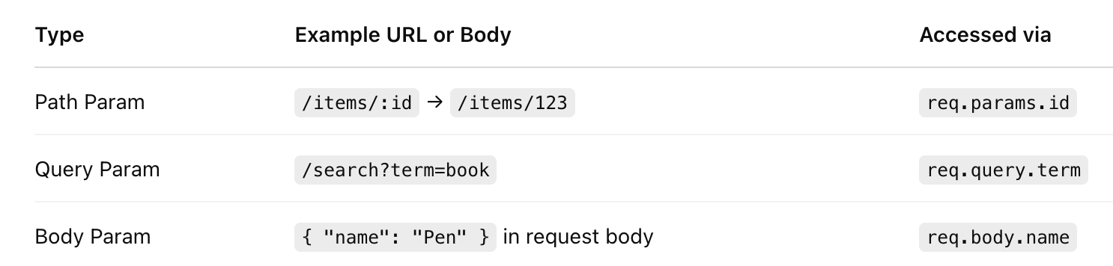
Difference

Slide 15
The res (Response) Object
Used to send data back to the client
Common methods:
res.send()
res.json()
res.status()
res.redirect()
res.end()

Slide 16
Response Type
res.send()
Sends a plain response (string, number, HTML)
res.send("Hello");
res.json()
Sends a JSON response (Content-Type = application/json)
res.json({ message: "Success" });
res.status()
Sets HTTP status code before sending a response
res.status(404).send("Not Found");

Slide 17
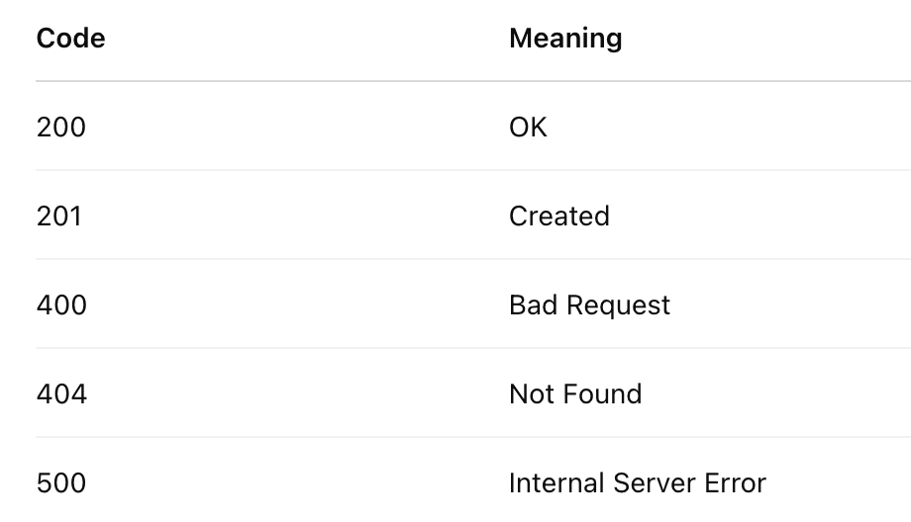
Statuses

Slide 18
Examples of Status
Sending 200 (OK)
res.status(200).json({ message: "Success" });
Sending 201 (Created)
res.status(201).json({ message: "Item Created" });
Sending 404 (Not Found)
res.status(404).send("Item not found");
Sending 500 (Server Error)
res.status(500).json({ error: "Something went wrong" });

Slide 19
Sending user example
res.status(200).json(user); // send user with 200 OK
res.status(200) sets the response status code to 200 OK.
.json(user) sends the user object in JSON format:
{
"id": 1,
"name": "John Doe",
"email": "john@example.com"
}

